Slide 1
The Question
Is resistance or symbiosis more successful in a bacteria-phage model for evolutionary rescue?
The Model: Phages, Symbionts and Resistants
Symbiosis is fast but risky. Every wt cell can become a symbiont right away, but they can later be killed by induction.
Resistance is slow but safe. It needs a rare mutation and has a growth cost, but it is permanent.
wt infection & symbiosis is correlated with phage population size

Slide 2

WT
resistant
symbiotic
Phages
infection death
lytic death
offspring WT
New Phages
offspring r
offspring s
New Phages
fitness cost
mutation
symbiosis
Population t
Phages
New WT
New r
New s
Population t+1
Notes:
Variable
-Number of wt individuals (N_wt)
-Number of resistant individuals (N_r)
-Number of symbiotic individuals (N_s)
-Population size of phages (N_p)
Parameters
-N_init_wt: initial population size of wild-type population (should be a positive integer)
-N_init_r: initial population size of the mutant resistant population (should be a non-negative integer)
-N_init_s: initial population size of the symbiotic population (should be a non-negative integer)
-N_init_P: initial population size of the phage population (should be a positive integer)
-growth_rate: average number of offspring per bacterium (wt, r and s) per generation (should be a non-negative integer)
-symbiosis_prob: probability that wt bacterium becomes symbiotic (range 0-1), should be bigger than mutation rate
-mut_rate: probability that an offspring of wt bacterium mutates to resistant
-infection_prob: probability that wt bacterium is infected by a phage per generation (range 0-1) ~ wt death rate
-induction_prob: probability (per generation) that a symbiotic bacterium is killed by its own dormant phage (range 0-1) ~ symbiotic death rate, should be smaller than infection rate
-cost_r: fraction of offspring that resistant bacteria lose compared to wt ->fitness cost of resistance (0-1) --> 1 is maximal cost, 0 is no cost. cost should be smaller than induction rate
-K: carrying capacity of the total bacteria population (wt + r + s)
-P_decline: fixed decline of phages
-P_prod: Number of new phages produced from an infection or induction
-t_max: number of generations after which to stop the simulation

Slide 3
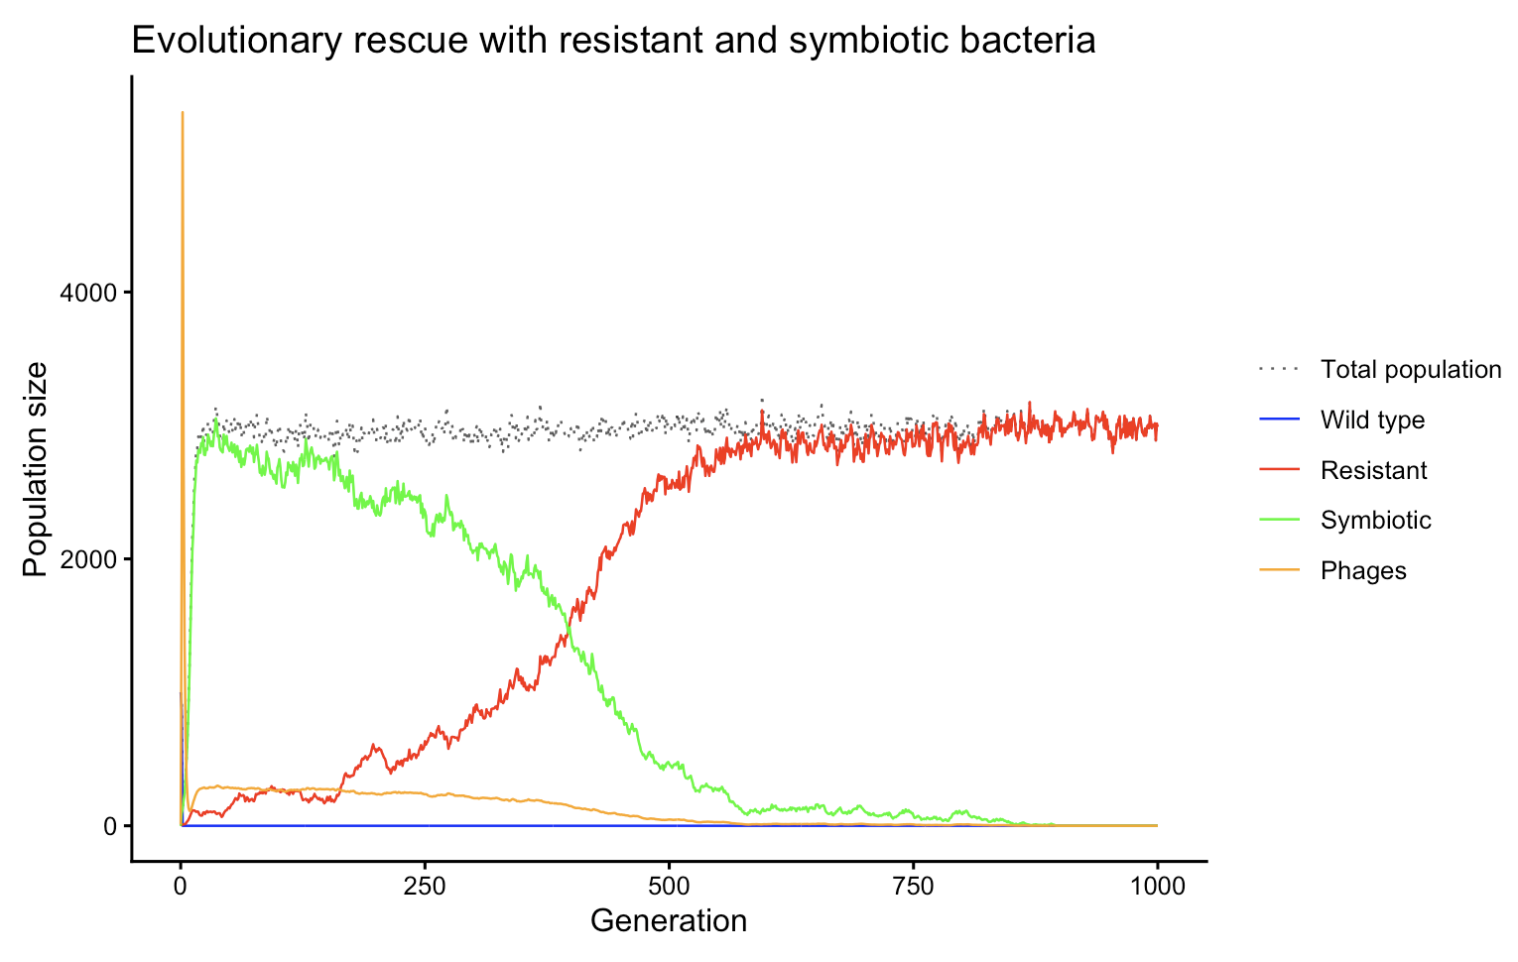
The Result: Slow r overtakes fast s
K = 3000
Notes:
First symbiosis is taking over but after multiple generations the resistant individuals win. This makes sense because symbiosis is fast since every wt can become symbiotic, but it’s costly which is shown by the induction probability; it acts like a death rate for the symbiotic bacteria. Once induction occurs, the phage switches from the lysogenic to the lytic phase, killing its host.
The resistant individuals are slow at first since they need a rare mutation and they have a cost (which is still smaller than induction probability) but it is permanent, which explains why they take over after ~500 generations. Once the resistant bacteria take over and the symbiotic bacteria have reached extinction, there are no hosts left for the phages so they go extinct as well.
The dotted black line shows the total bacterial population which fluctuates around the carrying capacity (3’000) throughout all generations.

Slide 4
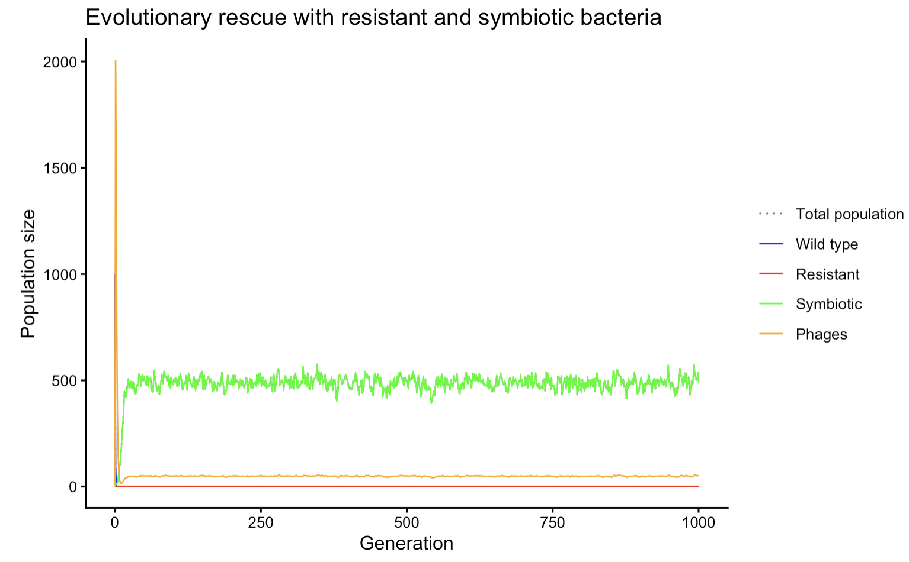
The Result: Effect of K, s wins
K = 500
Notes:
In this simulation we kept the same parameters but changed the carrying capacity to 500. This now shows that if we lower the carrying capacity (from 3000 to 500) the resistant bacteria have no chance to grow and the symbiotic is favored.

Slide 5
The Conclusion and the Outlook
Threshold K for Resistant overtake?
Consistent analysis: insight into stochastic outcomes
Adjustments for consistent anlysis?

